Slide 1
Introduction to the Roman Empire
Exploring the Rise and Fall of an Ancient Superpower

Slide 2
Overview of the Roman Empire
The Roman Empire was one of the largest and most powerful empires in ancient history.
It spanned over three continents and lasted for nearly five centuries, from 27 BC to 476 AD.
The empire had a significant impact on Western civilization, shaping various aspects of government, law, architecture, and culture.

Slide 3
Founding of Rome
The city of Rome was founded in 753 BC by Romulus and Remus, who were said to be raised by a she-wolf.
Rome started as a small settlement and gradually grew into a powerful city-state.
It eventually became the capital of the Roman Republic and later the Roman Empire.

Slide 4
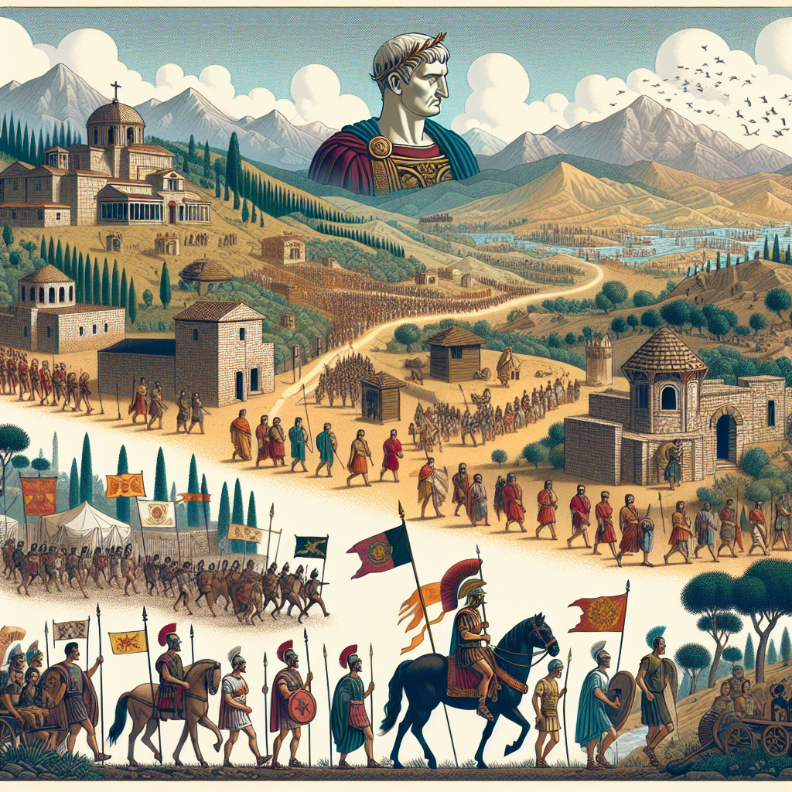
Expansion of the Roman Empire
The Roman Empire expanded through military conquests and strategic alliances.
It gradually conquered and assimilated various regions, including Gaul (modern-day France), Britannia (modern-day United Kingdom), and parts of Africa and Asia.
The empire reached its greatest territorial extent during the reign of Emperor Trajan in the 2nd century AD.
Roman Empire Expansion

Slide 5
Roman Government and Law
The Roman Empire had a complex government system with a mix of monarchy, republic, and autocracy.
It had an elaborate legal system, including the famous Twelve Tables, which codified Roman laws and principles.
Roman law has had a lasting influence on legal systems around the world.

Slide 6
Roman Architecture and Engineering
The Romans were renowned for their architectural and engineering achievements.
They built impressive structures such as the Colosseum, aqueducts, and roads.
Roman architecture and engineering techniques continue to inspire modern construction.

Slide 7
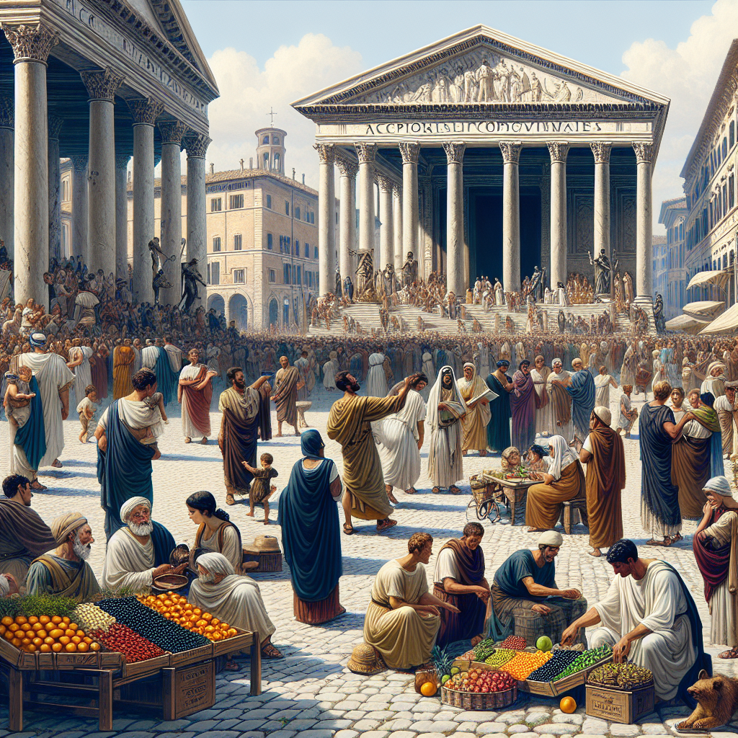
Roman Culture and Society
Roman culture was a blend of influences from the various regions and peoples within the empire.
They excelled in literature, art, philosophy, and entertainment, including gladiator fights and chariot races.
Roman society was hierarchical, with social classes ranging from slaves to aristocrats.
Roman Culture

Slide 8
Roman Religion and Mythology
Roman religion was polytheistic, with a pantheon of gods and goddesses.
They worshipped deities such as Jupiter, Mars, Venus, and Minerva.
Roman mythology influenced art, literature, and religious practices throughout the empire.

Slide 9
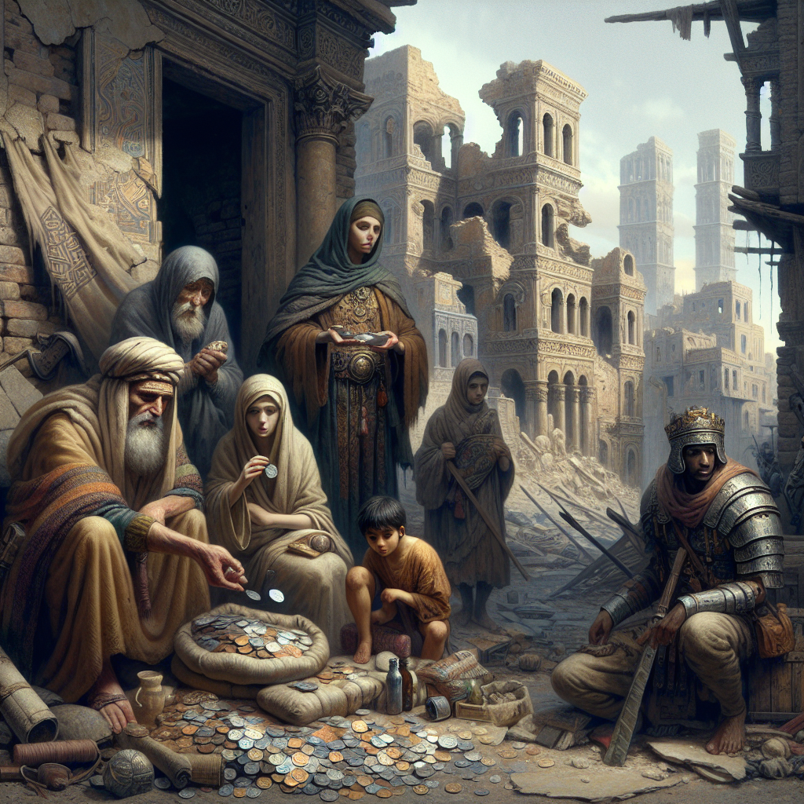
Decline and Fall of the Roman Empire
The Roman Empire faced numerous challenges, including internal conflicts, economic crises, and invasions by barbarian tribes.
The empire eventually split into two halves, with the Western Roman Empire collapsing in 476 AD.
The fall of the Roman Empire marked the end of ancient Rome and paved the way for the Middle Ages in Europe.
Fall of the Roman Empire

Slide 10
Legacy of the Roman Empire
The Roman Empire's legacy can be seen in various aspects of modern society.
Its language, Latin, has influenced the development of Romance languages such as French, Spanish, and Italian.
Roman concepts of law, government, and architecture continue to shape our world today.

Slide 11
Archaeological Discoveries
Archaeological excavations have unearthed many artifacts and structures that provide insights into Roman life and culture.
Discoveries such as Pompeii, the Colosseum, and Roman villas offer glimpses into the past.
Ongoing research and discoveries continue to expand our knowledge of the Roman Empire.

Slide 12
Conclusion
The Roman Empire was a remarkable civilization that left a lasting impact on the world.
Its accomplishments in government, law, architecture, and culture continue to influence us today.
Exploring the rise and fall of the Roman Empire offers valuable insights into the complexities of ancient societies.

Slide 13
References
1. Beard, M. (2015). SPQR: A History of Ancient Rome. Liveright Publishing Corporation.
2. Grant, M. (1978). The History of Rome. Faber & Faber.
3. Goldsworthy, A. (2016). Pax Romana: War, Peace and Conquest in the Roman World. Yale University Press.

Slide 14
Thank You
Thank you for your attention!
Any questions?

